Slide 1

Distributed SDN on WWAN
Responsible Professor: Univ.-Prof. Dr. rer. nat. Jochen Seitz
Supervisor: M.Sc. Matthias Aumüller
Name: Mamdouh Muhammad

Slide 2
Outline
Basics
state-of-the-art
Problems regarding standard SDN
Motivation and Introduction
Approach
Implementation and design of system
Conclusion
References

Slide 3

Basics
Coverage
LAN
WAN
Medium
Wired
Wireless
Communication
LAN (Local Area Network)
WAN (Wide Area Network)

Slide 4
Basics
Coverage
WAN
Medium
Wireless
WWAN
Communication
LAN (Local Area Network)
WAN (Wide Area Network)

Slide 5
Basics
HAMNET (Highspeed Amateur radio Multimedia NETwork):
5,650 GHz till 5,850 GHz -, 3,400 GHz bis 3,475 GHz –2,300 GHz and 2,450 GHz.
AMPRNet (AMateur Packet Radio Network) - Network 44 - (44.0.0.0/8).
Autonomous System (AS) numbers out of the 16-bit and 32-bit private AS number.
Limited dependency on Internet.
No general encryption

Slide 6
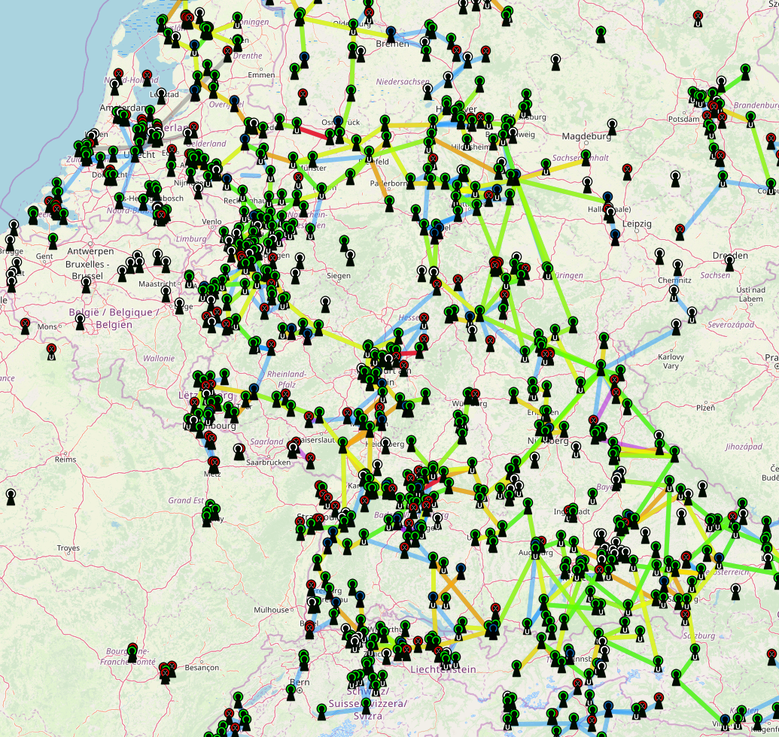
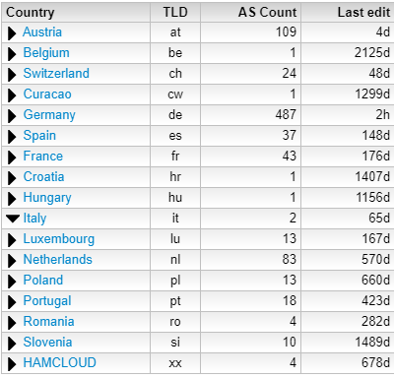

Slide 7
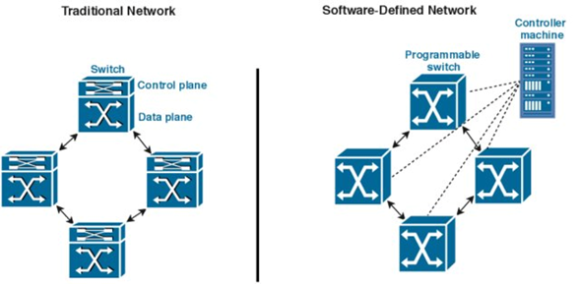
SDN
Approach to network management
Efficient network configuration.

Slide 8
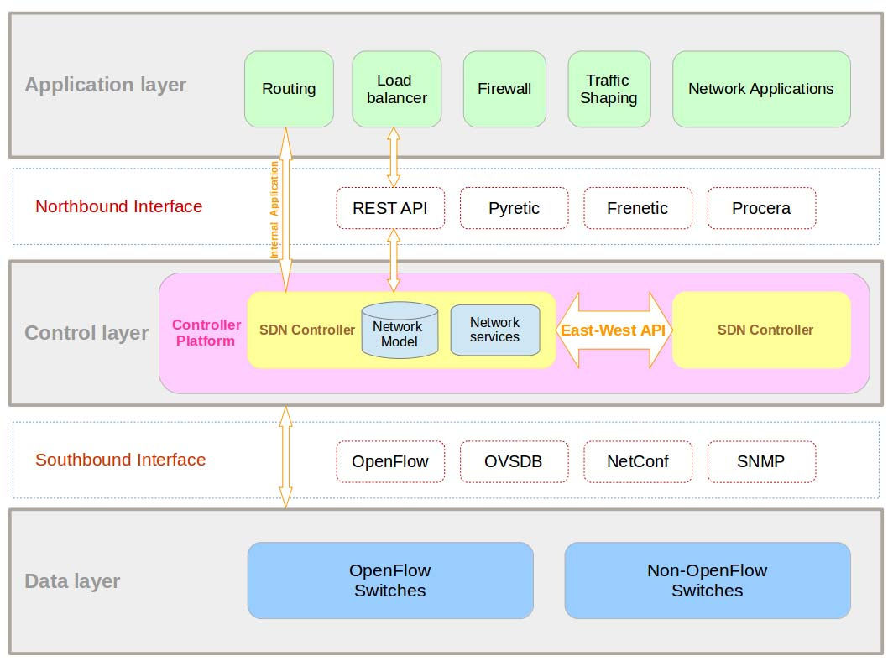
Advantages: 1- Management and orchestration via API.
2- Response to Link or Node failure is fast. 3- Less time consuming.
Disadvantages(centralized): 1- SPOF Single Point Of Failure. 2- SPOA Single Point Of Attack.

Slide 9
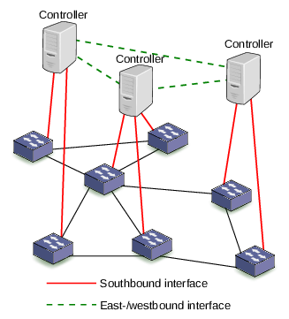
Distributed SDN:
Advantages:
1- Availability. 2- Load balancing.
3- Scalability

Slide 10
Motivation
Compare single controller and multi-controller scenarios
Feasibility of using distributed SDN in WWAN via using an IP routing protocol.

Slide 11
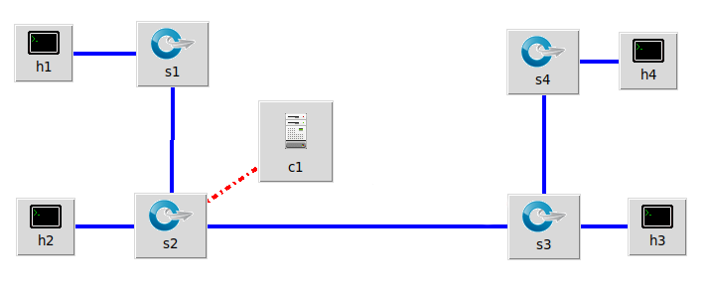

Slide 12
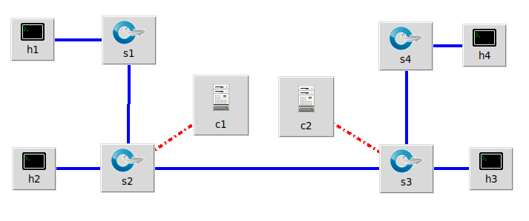

Slide 13
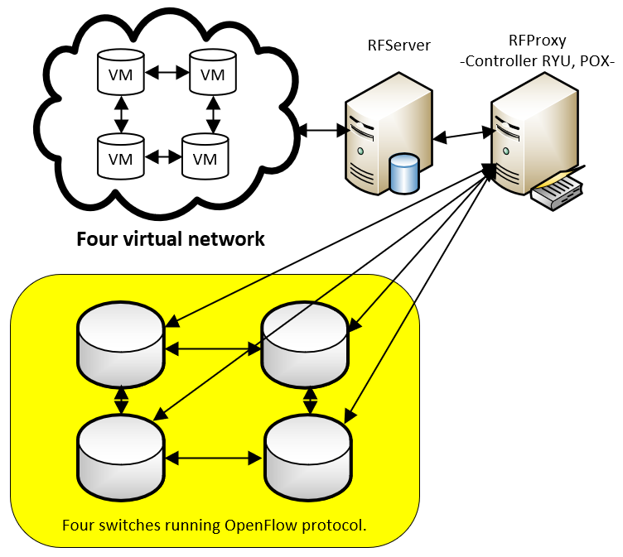
Proposed approaches
RouteFlow

Slide 14
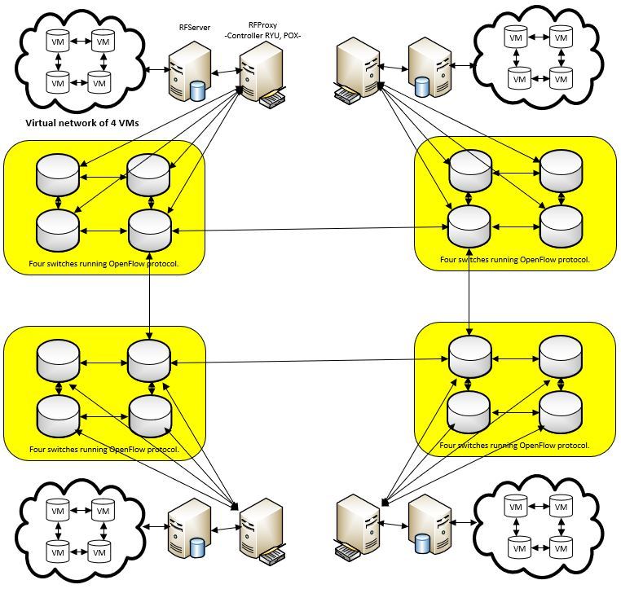
Proposed approaches
RouteFlow
RF controller
RF Server
RFClient
OSPF (Open shortest path first)

Slide 15
Results
Centralized SDN vs Distributed SDN
RouteFlow approach validity
IP routing protocols

Slide 16
Resources
http://www.bravo37.de/hamnet/#1
https://hamnetdb.net/
Ali Malik and Benjamin Aziz and Chih-Heng Ke (THRIFTY: Towards High Reduction In Flow Table memory) URL = {http://drops.dagstuhl.de/opus/volltexte/2019/10183}
Software-Defined Networking Using OpenFlow: Protocols, Applications and Architectural Design Choices, URL = https://doi.org/10.3390/fi6020302
F. Bannour, S. Souihi and A. Mellouk, "Distributed SDN Control: Survey, Taxonomy, and Challenges," in IEEE Communications Surveys & Tutorials, vol. 20, no. 1, pp. 333-354, Firstquarter 2018. doi 10.1109/COMST.2017.2782482
Liehuang Zhu, Member, IEEE, Md Monjurul Karim, Kashif Sharif, Member, IEEE, Fan Li, Member, IEEE, Xiaojiang Du, Senior Member, IEEE, and Mohsen Guizani, Fellow, IEEE (SDN Controllers: Benchmarking & Performance Evaluation)
https://www.tapr.org/pdf/DCC2014-TheEuropeanHAMNET-DG8NGN.pdf
Mengchen Shi Apoorv Shukla and Anja Feldmann. “Automatic Custom Generation of Topologies and Configuration
of Routing protocols in SDN”. In: Proceedings of the SIGCOMM Posters and Demos (August 2017).
CPqD. URL: https://sites.google.com/site/routeflow/.
CPqD. RouteFlow. URL:https://routeflow. github.io /RouteFlow/.
Bob Lantz and Gregory Gee. URL: https://github.com/mininet/mininet/blob/master/examples/miniedit.py.
Mininet Team. URL: http://mininet.org/.

Slide 17
Thank You

Slide 18
